Slide 1
Final Poster

Slide 2
Final Poster Content
Introduction Tells us why the topic is interesting
Methods Tell us what you did
Results Tell us what you found
Discussion Tells us why what you found is interesting

Slide 3
Final Poster: Introduction
Information to Include
Figures to Include
Why is the topic important?
Relevant background.
Your motivating question or goal
Study Area Map
A picture

Slide 4
Final Poster: Methods
Information to Include
Figures to Include
General goal or research question.
General approach
Important decisions you made in your anaysis
Method steps that are easier to represent as a figure.
Table of data layers

Slide 5
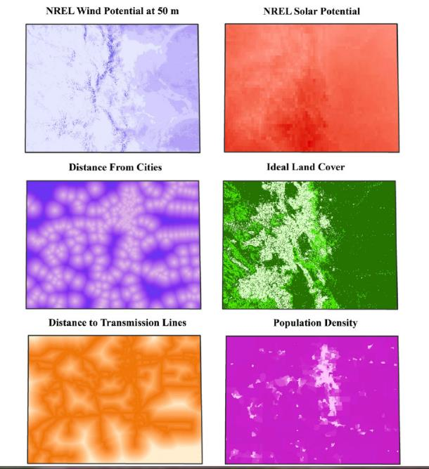
Final Poster Content: Methods
Highlight any important intermediate steps

Slide 6
Final Poster: Results
Information to Include
Figures to Include
Description of major findings, such as:
Statistical or numeric results
Graphical results
Charts
Tables
Maps!
Plot or tables of important results:
Histograms
Scatterplots
Boxplots
Maps!

Slide 7
Final Poster: Discussion
Were there any notable limitations?
Summarize important take-home points.
What are the big-picture conclusions?
What are the next steps?

